Slide 1
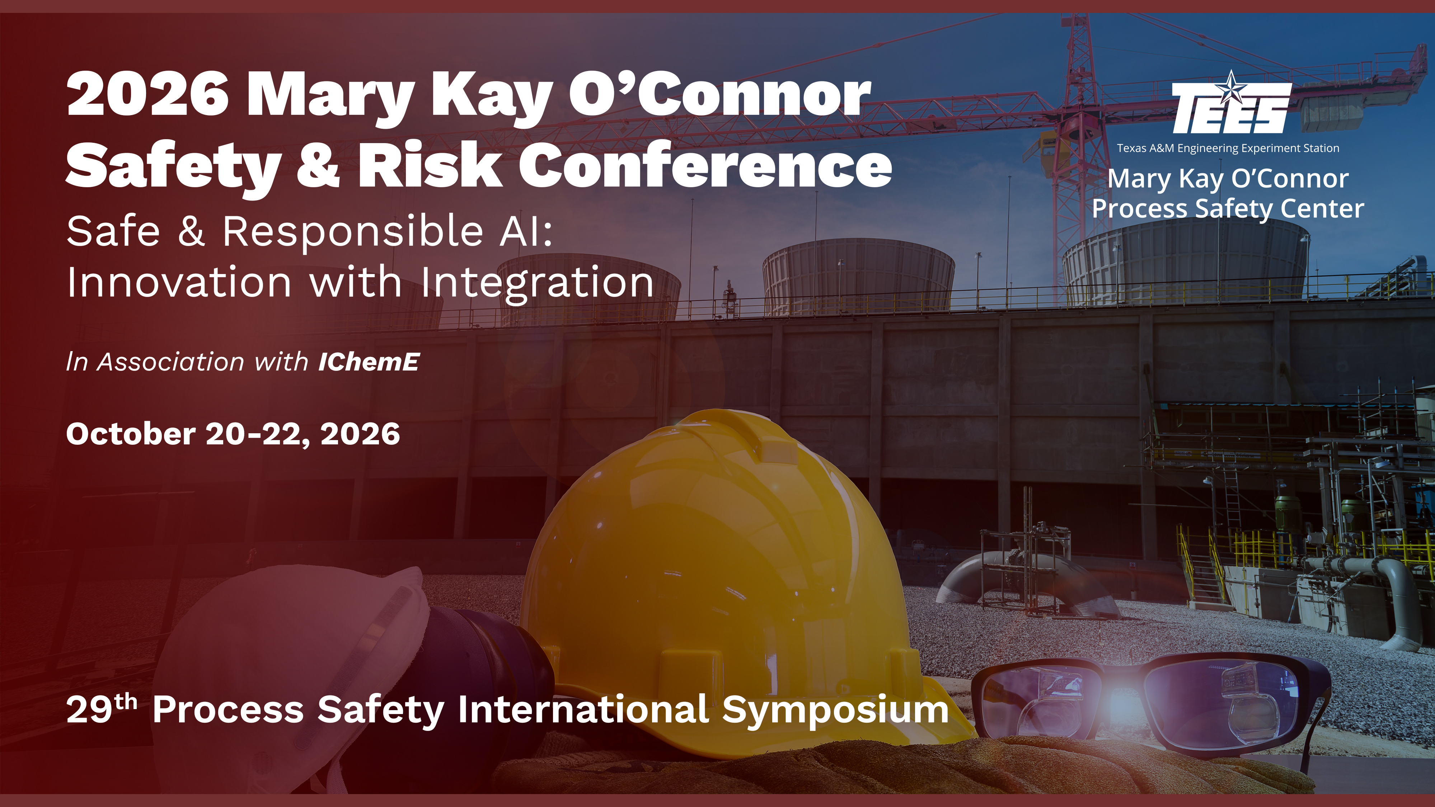

Slide 2
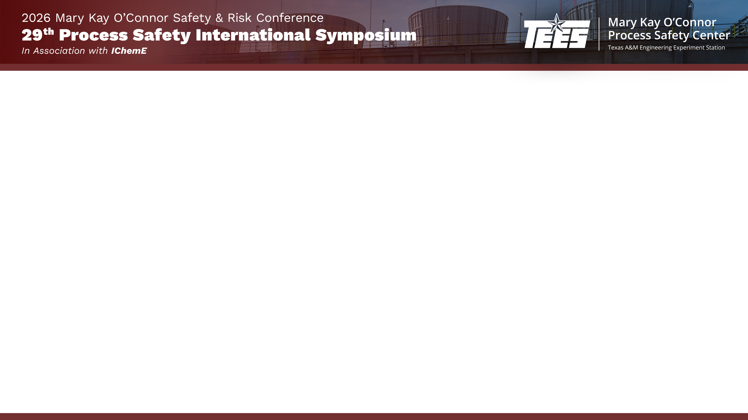


Speaker profile
Title: A Unified Framework for Mechanical Seal Risk Assessment
Improving Risk Decisions for Engineered Seal Systems in HAZOP and LOPA Studies
Maziar Amouie, P.Eng., CFSE, MIChemE, is a Process Safety Engineer with over 25 years of oil and gas experience. His expertise includes process safety management, functional safety, HAZOP, LOPA, SIL studies, quantitative risk assessment, consequence modeling, and safeguarding strategies. He currently supports Shell as a HEMP Process Safety Engineer and leads Premium Safety Solutions. His work focuses on risk-based decision making, barrier management, asset integrity, and process safety improvement for high-hazard facilities.
Umeet Bhachu, P.Eng., PMP, CMRP, is a Staff Rotating Equipment Engineer at Pembina Pipeline Corporation with over 20 years of oil and gas experience. His expertise includes turbomachinery, rotor dynamics, compressors, pumps, mechanical seals, troubleshooting, and reliability improvement. He has also applied machine learning and advanced analytics to condition monitoring and asset performance.

Slide 3
Purpose and Scope of the Presentation
Mechanical Seal Risk
Process Hazard Assessment
Risk Assessment Consistency
Aging & Grandfathered Facilities
Integrated Risk Framework

Slide 4
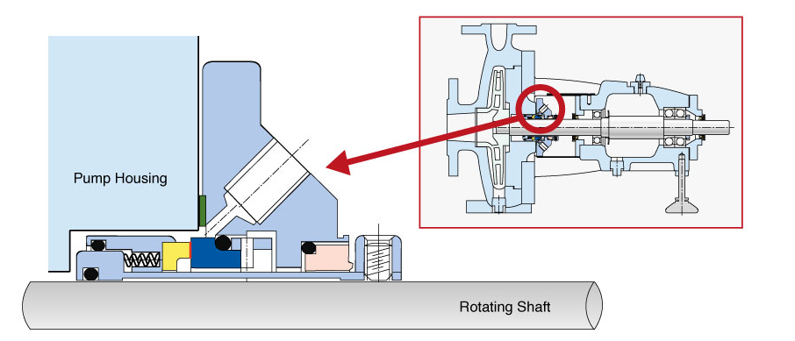
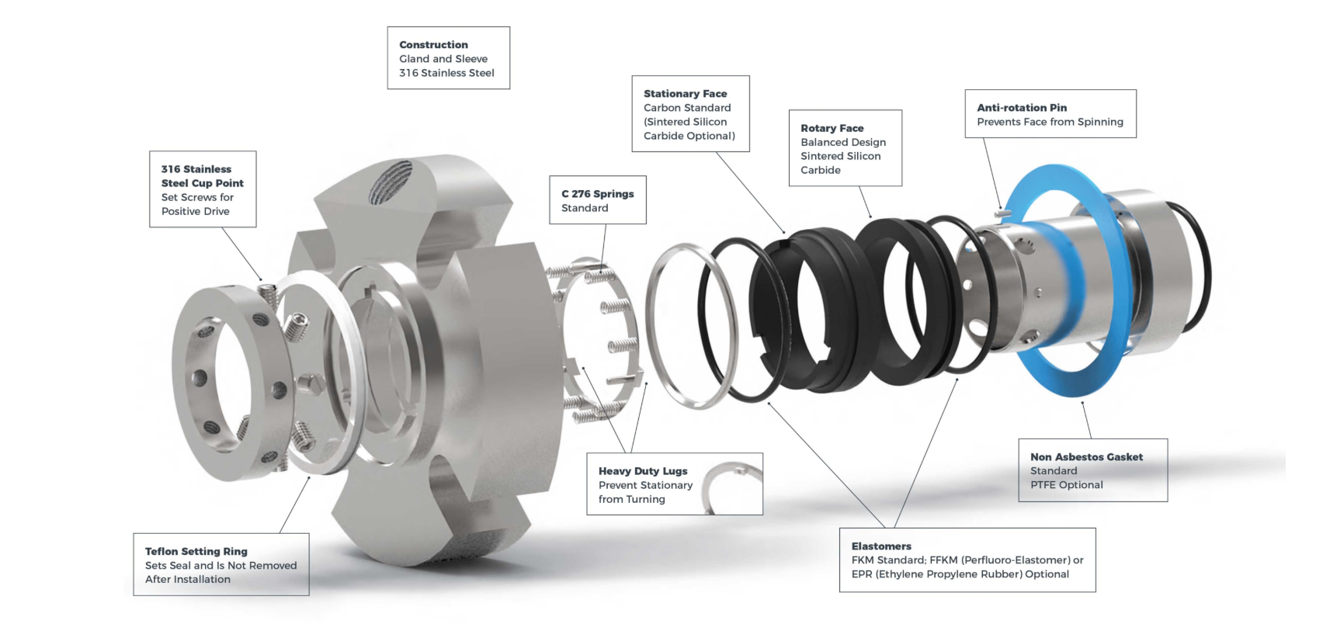
Mechanical seals and Sealing Systems – Small but Critical Components
Developed to reduce leakage and emissions compared with packing
Well suited to high-speed rotating equipment and turbomachinery
Primary seal uses stationary and rotating ultra-flat faces
Spring and hydraulic forces maintain an approximately 1-micron fluid film
Contamination, heat, pressure changes, and vibration can destabilize the film
API 682 guides seal selection and seal-support-system design
Key message: All mechanical seals leak—the objective is controlled leakage.

Slide 5
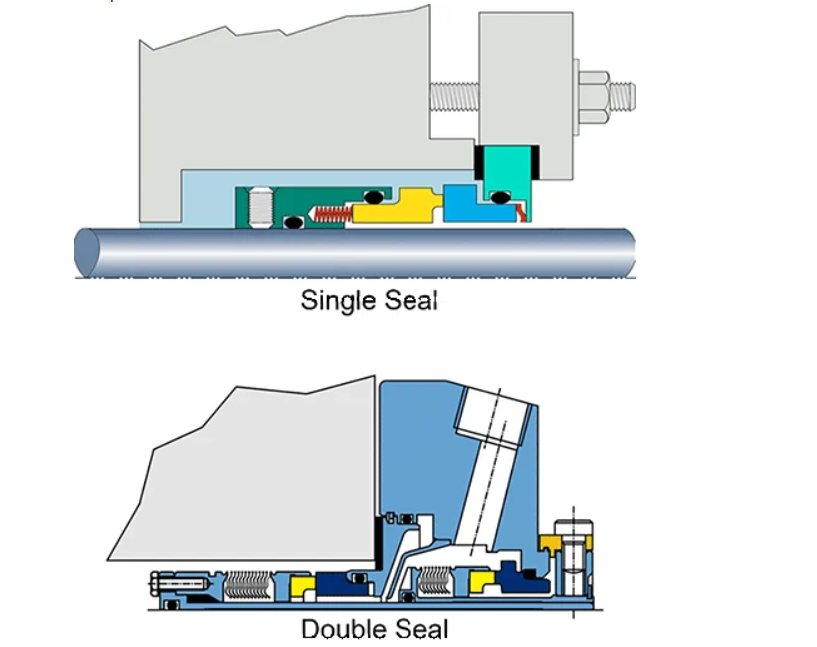
Types of Mechanical Seals
Single seals: One rotating and one stationary face; used for clean, low-risk services
Dual seals: Two sealing sets with buffer or barrier fluid; used for hazardous or difficult fluids
Split seals: Installed without major equipment dismantling; useful for large equipment
Balanced seals: Reduced hydraulic face loading for higher pressure and lower heat generation
Metal bellows seals: Non-pusher design suited to very high or low temperatures
Slurry seals: Hard, wear-resistant materials for fluids containing solids
Arrangement 1: One seal per cartridge assembly
Arrangement 2: Two seals with the inter-seal pressure below seal-chamber pressure
Arrangement 3: Two seals with externally supplied barrier fluid above seal-chamber pressure
Typical application progression:
Arrangement 1 — lower-risk service
Arrangement 2 — leakage containment
Arrangement 3 — maximum process isolation

Slide 6
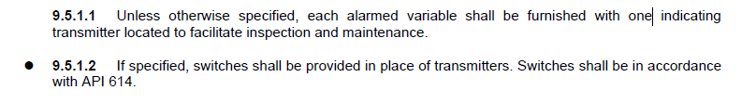
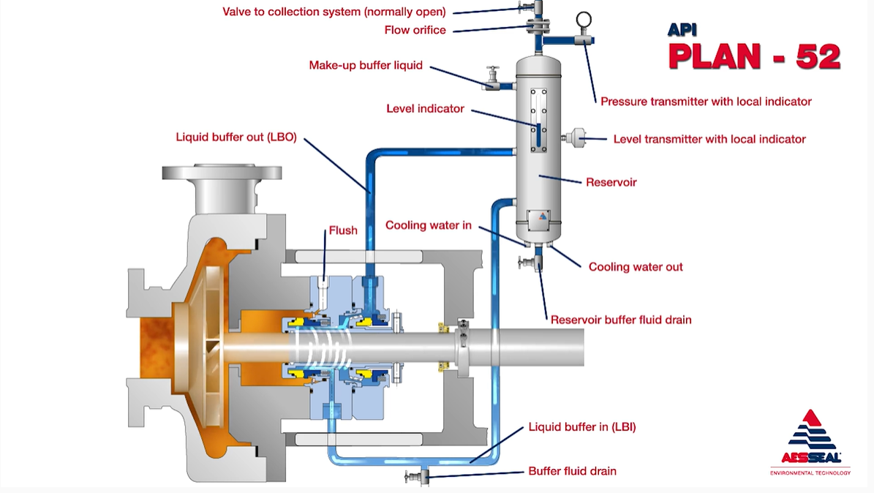
Role of SME in API 682 Selection Ensuring Safe operation
API 682 bullet symbol: purchaser decision or additional information required
Transmitters are the default requirement for alarmed variables, Switches should only be used
when specifically selected
Selection should consider fluid hazard, emissions risk, seal arrangement, and failure
consequence, transmitters support trending, early warning, and better
diagnostics
Unpressurized seal plan, for instance plan 52 utilizes different trip interval settings in different
plants, this impacts process safety because if the primary seal fails with 15 minutes set on
pressure transmitter this can create dangerous situations. API 682 does not provide guidance.
Alarm trip points on sealing systems should be set decided not randomly but based on specific
design considerations and plant operating philosophies. For plan 52, look at chocked flow
condition for the process and that will help determine when the primary seal is in a failed state.

Slide 7
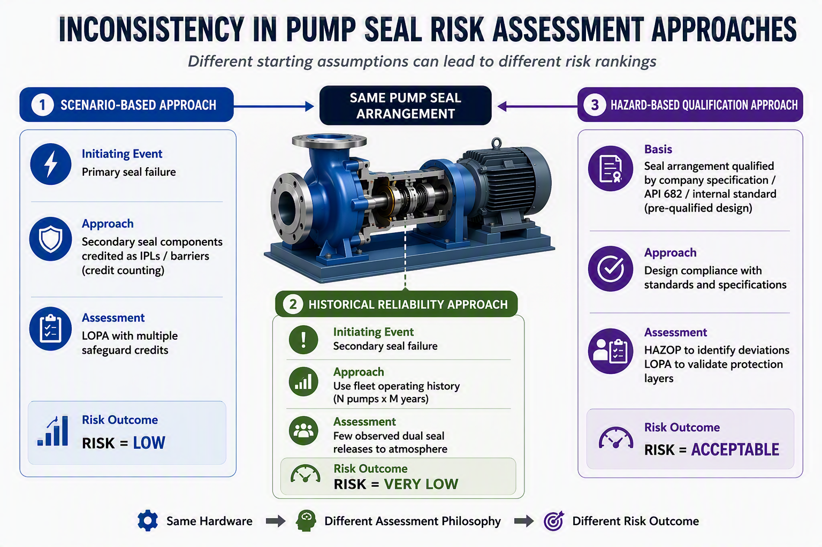
Why Is Consistency Important?
Challenge: The same pump seal arrangement can receive different risk rankings depending on the assessment methodology applied.

Slide 8
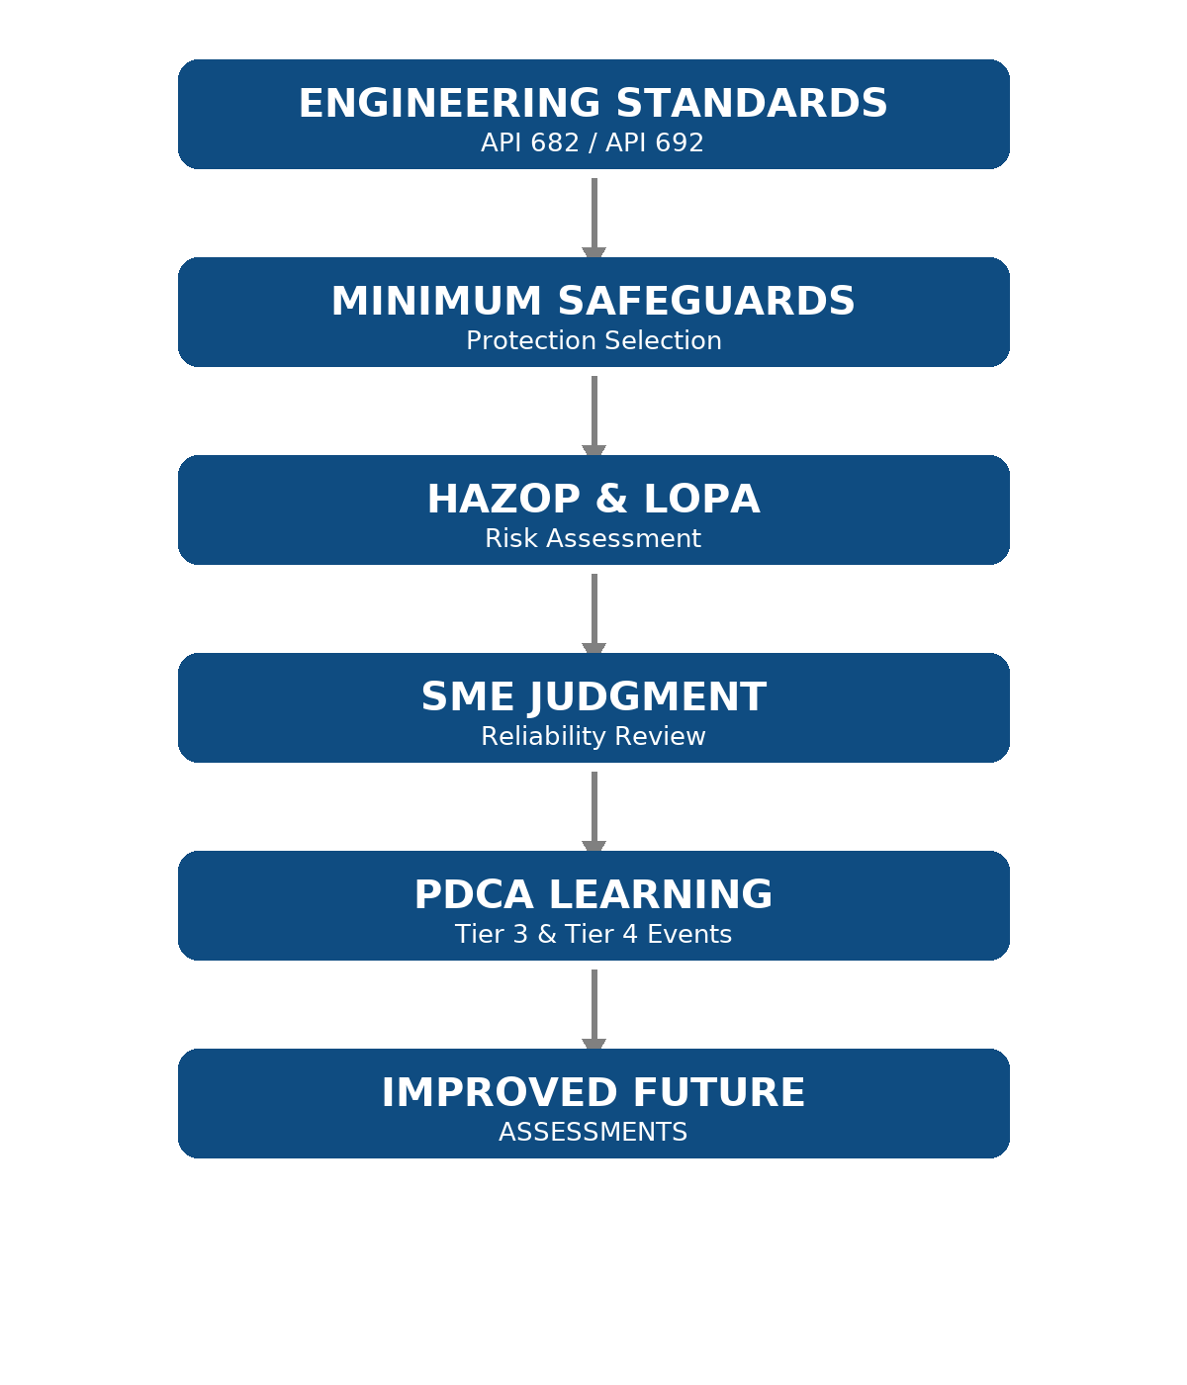
Proposed Assessment Approach
Engineering standards
Minimum safeguards
HAZOP & LOPA
SME judgment
Reliability learning

Slide 9
Complementary Assessment Techniques
FMEA- Failure Modes and Effects Analysis
Identifies potential equipment failure modes
Evaluates operational impacts
FMECA- Failure Modes, Effects and Criticality Analysis
Prioritizes failures based on consequence and likelihood
RCM- Reliability-Centered Maintenance
Optimizes maintenance strategies
Preserves equipment functionality
FTA- Fault Tree Analysis
Evaluates causal pathways
Identifies common-cause and dependent failures
HAZOP and LOPA should be complemented by reliability-based methods to better evaluate failure mechanisms, safeguard performance, and risk decisions.

Slide 10
29th Process Safety International Symposium
Establishing Minimum Safeguard Requirements
A generic, risk-informed in-house screening approach for pump/seal applications
1 EQUIPMENT / SERVICE
2 PROCESS FLUID HAZARD
3 OPERATING CHALLENGES
Duty / criticality
Pressure & temperature
Operating mode
Service severity
Toxicity
Flammability / ignition
Volatility / flashing
Corrosivity / environment
Deadhead / low flow
Away from BEP
Dry running / loss of suction
Cavitation / contamination
+
+
Then we can classify pumps to- higher risk = more safeguards
:
Lower, Medium, Higher or Categories 1, 2,3
MINIMUM SAFEGUARD BASELINE
Seal arrangement • Support system • Monitoring • Alarms / trips • Containment • Operating restrictions
Baseline first; HAZOP / LOPA then evaluates the specific hazardous scenario and need for additional risk reduction.
Supporting slide – Minimum Safeguards

Slide 11
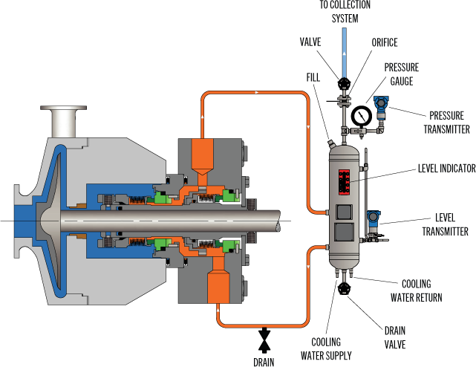
Plan 52 Mechanical Seal System: Risk Assessment Challenge
Can Plan 52 safeguards be credited as independent IPLs?
Following primary seal failure:
🔔 Low level alarm
⛔ High pressure trip
👷 Operator response
🛠 Maintenance program
HAZOP / LOPA Challenge
Applying SIDA Principles (Specify, Independence, Dependability, Auditability)
API Plan 52 | Flexaseal Engineered Seals and Systems

Slide 12
🟦 S – Specificity | Does specifically detect loss of buffer fluid and early seal degradation?
🟩 I – Independence | Is the safeguard independent of the initiating cause?
🟨 D – Dependability | Will the safeguard perform when demanded?
🟥 A – Auditability | Can performance be verified and documented?
Not All Safeguards Are Independent Protection Layers (IPLs)
• Common support equipment
• Instrument reliability
• Maintenance quality
• Operator response
• Shared failure mechanisms

Slide 13
Continuous improvement of Mechanical seal Risk Assessment
PLAN
Design & Assess
• API 682
• HAZOP & LOPA
• IPL assumptions
Reliability & Process Safety Indicators
Seal failure history
Loss-of-containment events
Barrier challenges (Tier 3)
Operating discipline indicators (Tier 4)
Maintenance findings
Root cause investigations
ACT
DO
Improve
• Reassess risk
• Update standards
• Lessons learned
CONTINUOUS
IMPROVEMENT
Operate & Maintain
• Operations
• Maintenance
• Alarm testing
CHECK
Monitor Performance
• Seal failures
• Tier 3 & 4 indicators

Slide 14
Grandfathering Is Not a Risk Assessment Strategy
Aging facilities require continued validation of safeguard effectiveness and risk tolerability.
🏗️ Design → ⏳ Time → 📍 Today → 🔍 Reassessment → 🛡️ ALARP
Continued operation of mechanical seal systems should not rely solely on historical design assumptions. Aging assets, operational experience, evolving standards, and reliability data should inform periodic reassessment to demonstrate that risk remains ALARP.

Slide 15
Closing Message
Consistency is achieved through the integration of engineering standards, PHA including HAZOP/LOPA, SME judgement and reliability learning.
Engineering standards establish the foundation, process hazard analysis evaluates risk, and reliability learning strengthens future decisions.

